Slide 1


<Name>
<Date>

Slide 2

Outline
Executive Summary
Introduction
Methodology
Results
Conclusion
Appendix

Slide 3
Executive Summary
We used rocket launch data from the spaceX API
We predict the likelihood of a successful rocked stage 1 landing based on launch-site, weight, orbit.

Slide 4
Introduction
Rocket launches are very expensive. Reusing the first stage of the rocket reduces the price for the launch.
How can we optimize the number of successful landings of stage 1.

Slide 5


Slide 6
Methodology
Executive Summary
Data collection methodology:
We used the SpaceX API and web-scrapping to get the data.
Perform data wrangling
We cleaned the data and reduced it to a relevant dataset
Perform exploratory data analysis (EDA) using visualization and SQL
Perform interactive visual analytics using Folium and Plotly Dash
Perform predictive analysis using classification models
We broke the data into train and test sets to train the predictive model and then test how well it predicts.

Slide 7
Data Collection
Primary data was collected through the SpaceX API
additional information got scrapped from wikipedia
dataset
SpaceX API
Wikipedia

Slide 8
Data Collection – SpaceX API
Called the spaceX API to get the data.
https://github.com/Supertyp/spaceibm/blob/79382cfb1aacf51db2c2d0a9f0d542e8b39ab7d3/capstone%20project%20space%20Y%20notebook.ipynb
Place your flowchart of SpaceX API calls here
Watson Studio
API

Slide 9
Data Collection - Scraping
Used beautifulsoup to get data out of the Wikipedia HTML page for Falcon landings
https://github.com/Supertyp/spaceibm/blob/master/web%20scrapping%20for%20space%20Y.ipynb
Watson Studio
Wikipedia
Place your flowchart of web scraping here
Get table data using beautiful soup
Get data into pandas format

Slide 10
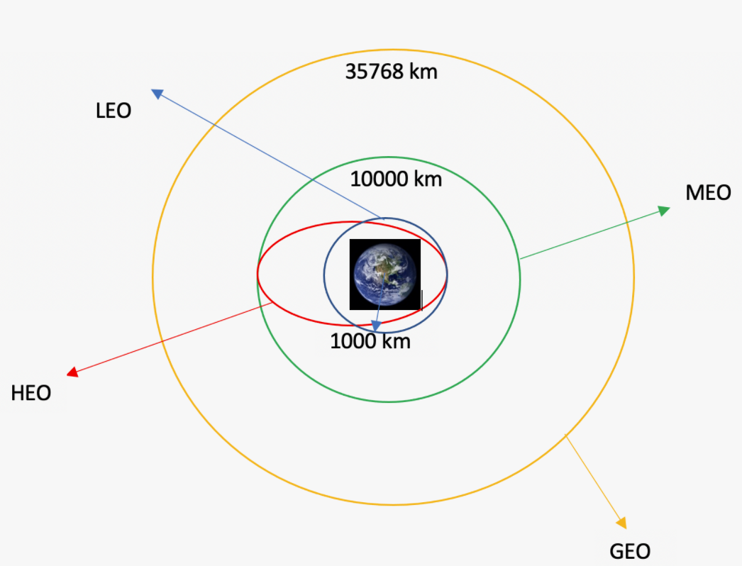
Data Wrangling
Calculated the landing outcome of every launch and added it to the dataset as “Class” column. Also included the orbits as category.
https://github.com/Supertyp/spaceibm/blob/master/data%20wrangling.ipynb

Slide 11
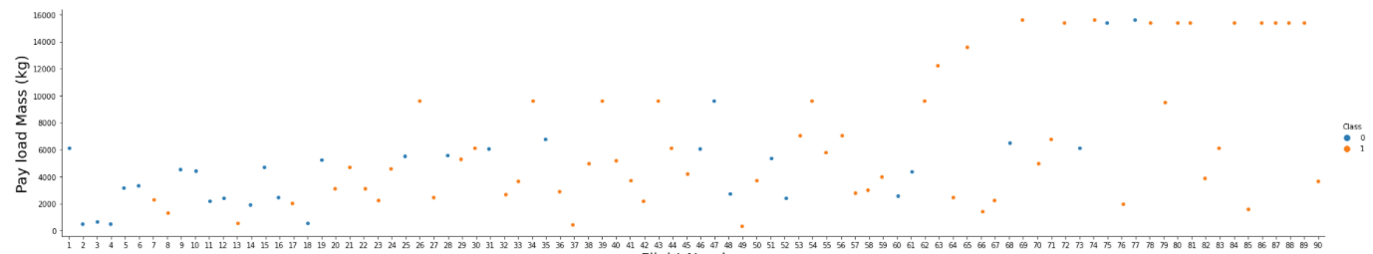
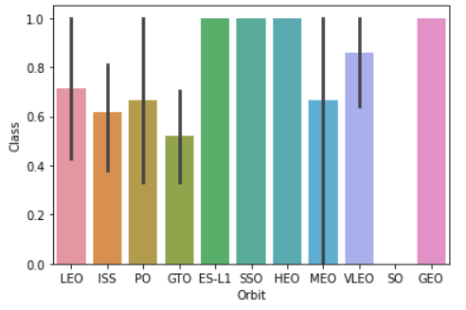
EDA with Data Visualization
We got the landing outcome depending on payload.
The same for orbit and launchsite
https://github.com/Supertyp/spaceibm/blob/master/data%20vis%20with%20matplotlib.ipynb

Slide 12
EDA with SQL
We used SQL magic in the Jupiter notebook to query for launchsites, payloads, when the first successful landing was archived, name of boosters.
https://github.com/Supertyp/spaceibm/blob/master/landing%20sql%20tutorial.ipynb

Slide 13
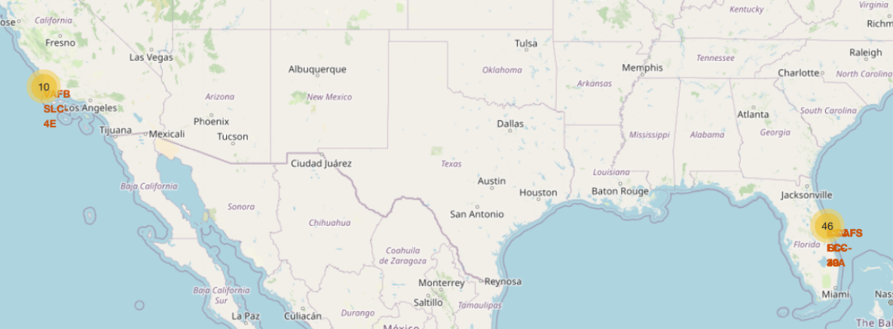
Build an Interactive Map with Folium
We added the stating and landing locations as markers on the map. One can now zoom in to see the location in detail.
The locations collapse into a number when you zoom out so the map is not clustered with markers
https://github.com/Supertyp/spaceibm/blob/master/Data%20dashboard%20with%20folium.ipynb

Slide 14
Build a Dashboard with Plotly Dash
The dashboard has a dropdown for the starting locations
The data can be filtered by the locations
It shows a pie chart and a scatterplot
https://github.com/Supertyp/spaceibm/blob/master/spacex_dash_app.py

Slide 15
Predictive Analysis (Classification)
We split the data into train and test set to train and test the model
We used logistic regression and GridSearch to predict the landing class
https://github.com/Supertyp/spaceibm/blob/master/predictive%20model.ipynb

Slide 16
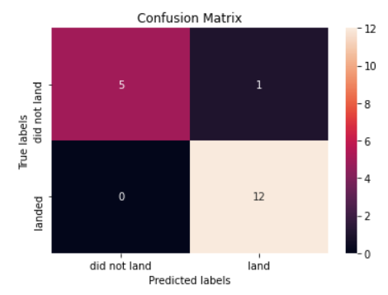
Results
We created the confusion matrix
It shows many false positives
Maybe K nearest neighbor bringsBetter results

Slide 17


Slide 18
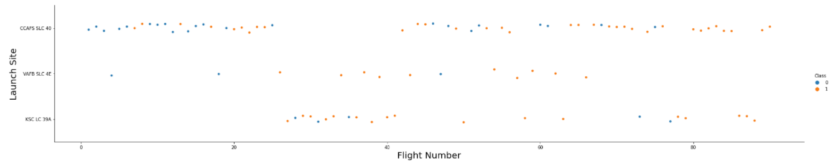
Flight Number vs. Launch Site
Of the three launch sites CCAPS SLC40 was the first used.
In the beginning many launches failed but by the end most launches were successful.

Slide 19
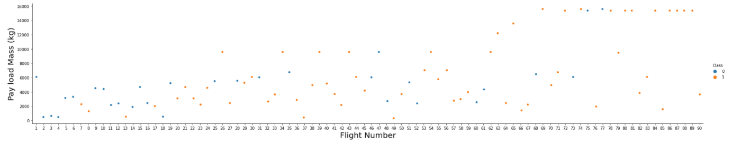
Payload vs. Launch Site
The payload has big influence on the success rate. The heavier the payload the more likely a successful landing.

Slide 20
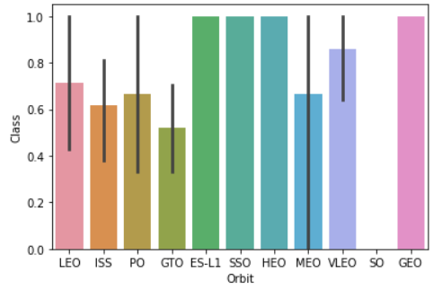
Success Rate vs. Orbit Type
Orbit type and success rate

Slide 21
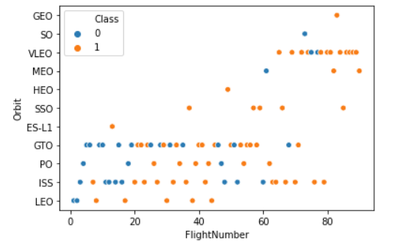
Flight Number vs. Orbit Type
Scatter plot of orbit type by flight number. VLEO orbit resulted in the highest number of successful landings

Slide 22
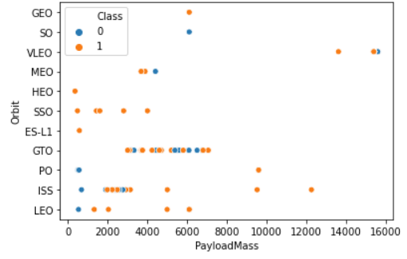
Payload vs. Orbit Type
Payload and Orbit type.
ISS was used first with lower payload
GTO was used later with higher payload

Slide 23
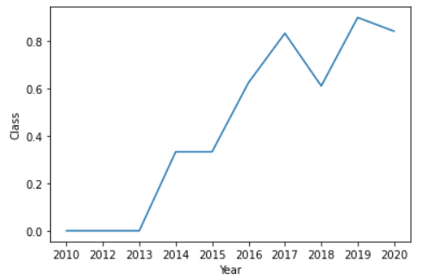
Launch Success Yearly Trend
Landing became more and more successful over the years.

Slide 24
All Launch Site Names
All launch sites:
CCAFS LC-40
SLC-4E
KSC LC-39A
CCAFS SLC-40

Slide 25
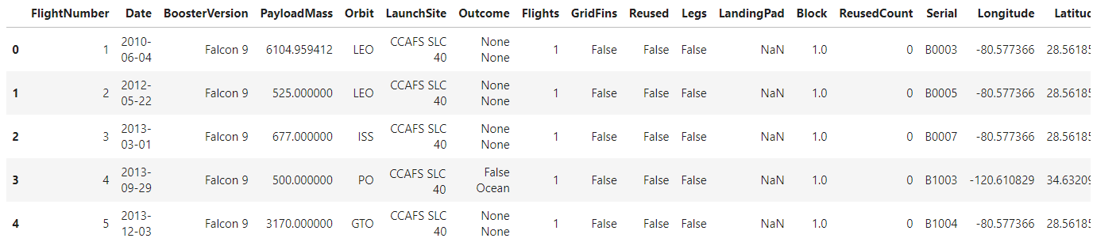
Launch Site Names Begin with 'CCA'
There are two launch sites starting with CCA
Here are the first five results when searching for them:

Slide 26
Total Payload Mass
549446.3470588236 is the total payload calculated with pandas .sum() function:
df['PayloadMass'].sum()

Slide 27
Average Payload Mass by F9 v1.1
The average payload mass carried by booster version F9 v1.1 is 6104.959411764707
Created a new filtered df:
df2 = df.loc[df["BoosterVersion"] == "Falcon 9"]
Then calculated the mean of Payload Mass:
df2["PayloadMass"].mean()

Slide 28
First Successful Ground Landing Date
The first successful landing outcome on ground pad was on: 2014-04-18
Filtered for successful landings and then found the earliest entry:
df3 = df.loc[df["Class"] == 1]
df3["Date"].min()

Slide 29
Successful Drone Ship Landing with Payload between 4000 and 6000
F9 FT B1022
F9 FT B1026
F9 FT B1021.2
F9 FT B1031.2
All landed successfully
SQL query is:
%sql select BOOSTER_VERSION from SPACEXTBL where LANDING__OUTCOME='Success (drone ship)' and PAYLOAD_MASS__KG_ BETWEEN 4000 and 6000;

Slide 30
Total Number of Successful and Failure Mission Outcomes
%sql select count(MISSION_OUTCOME) as missionoutcomes from SPACEXTBL GROUP BY MISSION_OUTCOME;
99/1 successful mission outcome

Slide 31
Boosters Carried Maximum Payload
boosterversion
F9 B5 B1048.4
F9 B5 B1049.4
F9 B5 B1051.3
F9 B5 B1056.4
F9 B5 B1048.5
F9 B5 B1051.4
F9 B5 B1049.5
F9 B5 B1060.2
F9 B5 B1058.3
F9 B5 B1051.6
F9 B5 B1060.3
F9 B5 B1049.7
Selecting the max payload from each booster carrier version: %sql select BOOSTER_VERSION as boosterversion from SPACEXTBL where PAYLOAD_MASS__KG_=(select max(PAYLOAD_MASS__KG_) from SPACEXTBL);

Slide 32
2015 Launch Records
%sql SELECT MONTH(DATE),MISSION_OUTCOME,BOOSTER_VERSION,LAUNCH_SITE FROM SPACEXTBL where EXTRACT(YEAR FROM DATE)='2015' GROUP BY MONTH(DATE)
Month by month failed landings for 2015

Slide 33
Rank Landing Outcomes Between 2010-06-04 and 2017-03-20
No attempt
Failure (drone ship)
No attempt
Controlled (ocean)
Failure (drone ship)
Uncontrolled (ocean)
No attempt
No attempt
Controlled (ocean)
Controlled (ocean)
No attempt
No attempt
Uncontrolled (ocean)
No attempt
No attempt
No attempt
Failure (parachute)
Failure (parachute)
landing__outcome
No attempt
Success (ground pad)
Success (drone ship)
Success (drone ship)
Success (ground pad)
Failure (drone ship)
Success (drone ship)
Success (drone ship)
Success (drone ship)
Failure (drone ship)
Failure (drone ship)
Success (ground pad)
Precluded (drone ship)

Slide 34


Slide 35
<Folium Map Screenshot 1>
Replace <Folium map screenshot 1> title with an appropriate title
Explore the generated folium map and make a proper screenshot to include all launch sites’ location markers on a global map
There are two major launch locations. One in California and one in Florida.

Slide 36
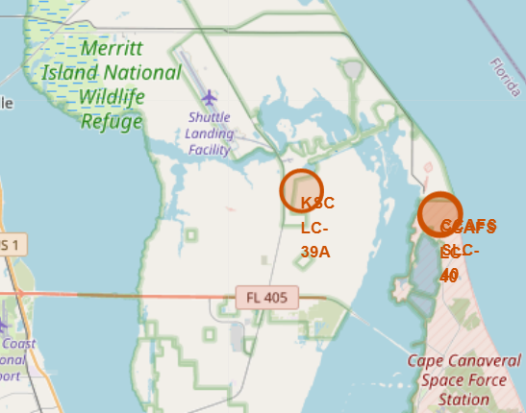
<Folium Map Screenshot 2>
Detail of lauch site in Florida

Slide 37
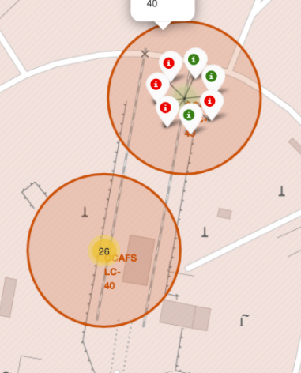
<Folium Map Screenshot 3>
Local area around the launch site

Slide 38


Slide 39
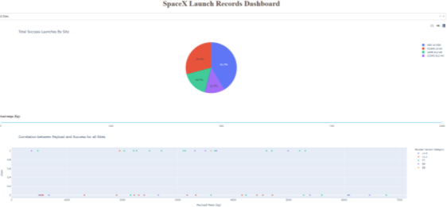
<Dashboard Screenshot 1>
Successful launches by launch site:

Slide 40
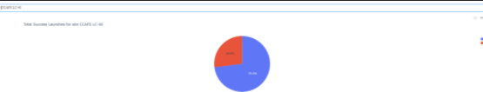
<Dashboard Screenshot 2>
Highest success rate of launch site:

Slide 41


Slide 42
Confusion Matrix
We get high accuracy
But there are many false positives

Slide 43
Conclusions
Point 1: Most launches result in a successful landing
Point 2: The payload correlates with success rate of the landing
Point 3: The landings are getting more successful over time
Point 4: The Orbits LEO and ISS result most likely in a successful landing

Slide 44


